Slide 1
Ameren Cloud Operating Model
Accenture Engagement
November 2020

Slide 2
Our Understanding
Ameren currently has about 10% of its applications in the public cloud with the rest of the applications in traditional datacenters.
Cloud Operations is currently fragmented and part of the application teams across the organization and Ameren is looking for a POV on the leading practices in the industry.
The organization would like to streamline its Operations, reduce its O&M cost and define a target state Operating Model.

Slide 3
Leading practice Approach
illustrative
The leading practice approach to manage Cloud Operations is to centralize and drive significant efficiencies in processes, tools and people.
Enables App teams to focus on business applications
Drive common practices across both on-prem and cloud functions
Leverage standardized process to drive on-prem and cloud services
Cross-train resources across on-prem and cloud service teams
Leverage common tools and platforms to drive efficiencies
Use common governance frameworks across both on-prem and cloud functions
Typical productivity benefits range from 20% - 50%
Business Value Streams & Application Services
Service Intake
Strategy & Governance
Facilitate introduction of new services and capture requirements
Set the Hybrid Infra Strategy
Service Development
Business Office
Architecture & Design Standards
Develop new and enhance existing services
Support the On-prem and Cloud operations
Drive performance management, cost management and Talent enablement
On Prem Operations
Cloud Operations
Define guiding principles and standards
Security
Providers

Slide 4
Hybrid Infra operating model - capabilities
illustrative
6 critical capabilities enable the Hybrid Infra Operating Model
Strategy & Governance - Sets the strategic guidelines for the evolution of the Operating Model, keeping it aligned with business objectives and the broader corporate strategy. Acts as the central governance body that interfaces into existing architecture, strategy and governance bodies.
Business Value Streams & Application Services
1
1
3
Reference Architecture & Design Standards - Governs Enterprise Services and Standard Architectures. Ensures that Development teams adhere to tightly controlled security and resilience standards. Defines controls that enable development team’s autonomy using proven, resilient and secure services
Service Intake
Strategy & Governance
2
Service Development
4
6
Service Intake and Cloud Enablement - Facilitates the introduction of new services in alignment with business priorities.. Manages cloud services and on-prem services demand.
Business Office
3
2
5
Architecture & Design Standards
On Prem Operations
Cloud Operations
Service Development - Develops new services, both for on-prem and cloud, makes them available through the service catalog, and manages the catalog while providing end-to-end integration services.
4
Security
Operations - Supports the On-prem and cloud operations and issue resolution. Provides service support and optimizes cloud assets with a focus on continuous improvement. The issue resolution is managed through a common service desk across on-prem and cloud.
5
Providers
Business Office - Enables the overall Infrastructure organization to deliver its commitments by driving performance management and security management and coordinating internal and external functions Manages show backs / charge back actions, training and talent management functions
Cross-train Operations resources to support both on-prem and cloud operations
6

Slide 5
Few Common processes across on-prem and cloud operations
Non-Exhaustive
Some common operational processes that can be used to operate the Infra/Cloud operations and drive standardization
Incident Management-support levels, IM process management, recovery, triaging, prioritization of defects, communication b/w teams, reports, single poc for end users
Patch/Update Management-
Capacity Planning-impact of technology due to projects, performance of systems during testing
Security Management – security config, code, testing new security, KPIs, impact of security changes,
Monitoring and Logging-
Backup and Disaster Recovery-
Change Management-
Automation and Orchestration

Slide 6
Key activities to build a business case
Key activities to develop a business case for consolidating the Cloud Operations as part of Infrastructure Operations:
Identify the key stakeholders and business teams supporting Cloud Operations currently
Conduct workshops with each business team to analyze:
Processes and tools
Resources
Roles and responsibilities
Skills
Ticket analysis
Automation
Methodologies (Agile, DevOps, SRE, etc.)
Metrics
Conduct a current state Operating Model assessment of the Infrastructure Operations
Skills required
Roles and responsibilities
Processes and tools
Methodologies used (Agile, DevOps, SRE, etc.)
Governance
Analyze the current state costs, standardization, and roles to leading practice Operating Model
Organizational Structure
COE
Roles and responsibilities
Processes, tools
Governance

Slide 7
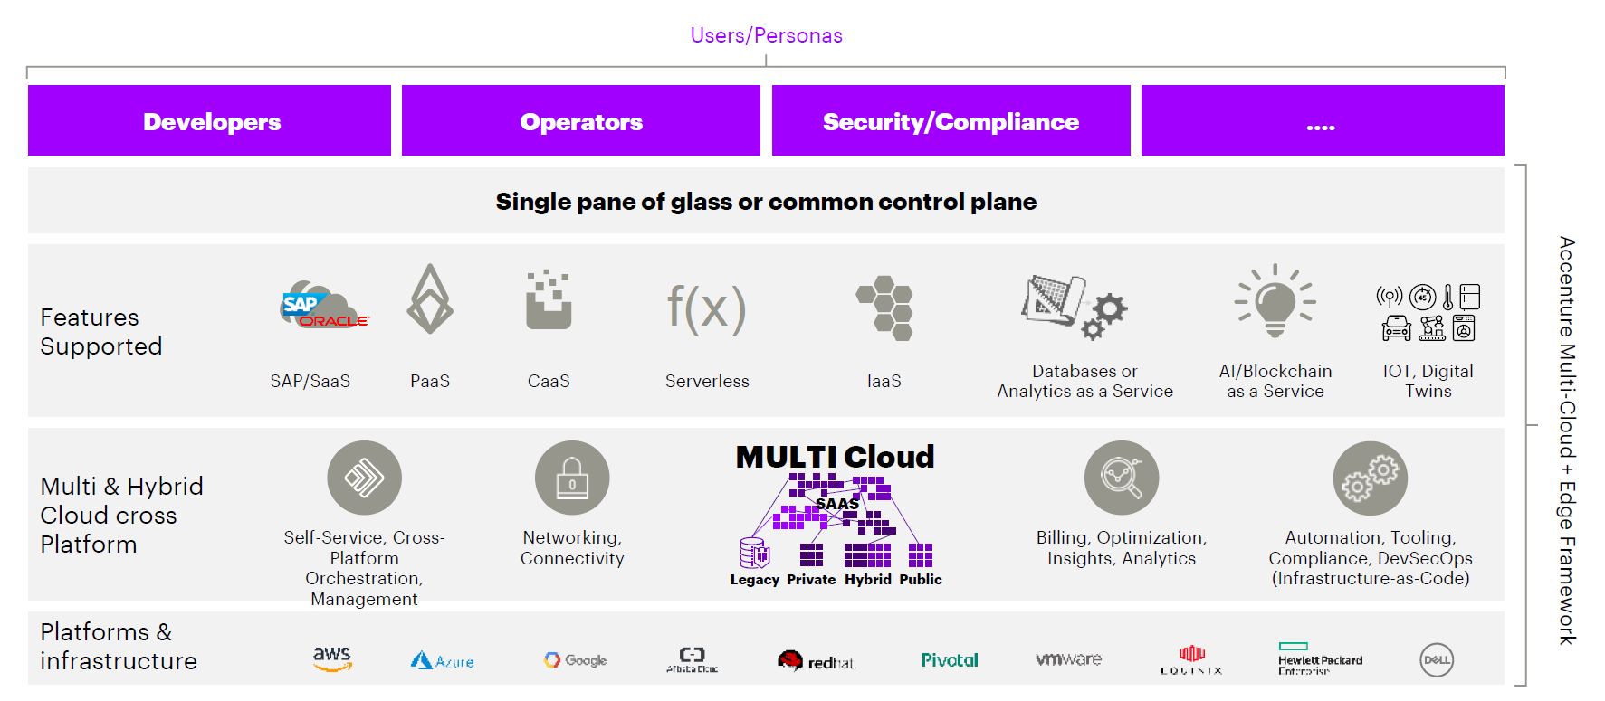











Hybrid Infra/Cloud Control Plane
Client Hybrid Environment build and transformation enablement
Features Supported
Multi & Hybrid Cloud cross Platform
Platforms & Infrastructure
Notes:
Edge Stories need to be focused.

Slide 8
Thank you

Slide 9
Enterprises have largely moved to a hybrid cloud strategy
Multi Cloud & Hybrid Cloud dominate
By industry: Regulated industries show the highest adoption rates for Hybrid Cloud
By geography: Hybrid Cloud predominates in Europe, where there is a limited percentage of pure Public Cloud users
93% of enterprises have a Multi Cloud strategy; 74% have Hybrid Cloud implementations (integrated Public & Private Cloud)
Enterprises average 7 Clouds under management
Cloud outcomes: Client satisfaction levels are highest with Hybrid Cloud (95%), better than with Public or Private only implementations.
Hybrid Cloud is the norm
Enterprise Cloud Strategy
Average 7 Clouds leveraged by organizations
Key market trends
Traditional ”Cloud native” Solutions are being deployed everywhere – not just on MAAG platforms including containers, CMS automation techniques and serverless.
MAAGs betting on Hybrid: By 2023, more than 50% of all workloads will leverage a Public provider’s Public Cloud, Hybrid and/or Edge offering.
Edge Computing: The “distributed Cloud” will be fueled by 5G adoption
Multi- Cloud
Single Public
Single Private
Hybrid Cloud
Multiple Public
Hybrid Cloud Dominant
Private only
Hybrid
Public only
Sources: IDC. Worldwide Whole Cloud Forecast, 2020–2024,
Gartner. Forecast Analysis: Cloud Consulting and Implementation Services, Worldwide, Mar. 2020
October 2020. Flexera. 2020 State of the Cloud Report

Slide 10

DevOps on hybrid infra/cloud use-cases
Offload development and testing environments on public cloud to facilitate concurrent development / agility / cost savings. Production environment remains On-premises.
Enable Cloud Bursting by provisioning additional capacity on Public cloud for temporary spike in private cloud workload.
Integration between System of Engagement applications and System of Record applications on legacy platforms / private datacenters / distributed physical infrastructure.
Maintain portability of application workloads across Private and Public clouds
01
02
03
04
Public Dev-Test – On Prem Prod
Bursting for Capacity needs
SoR & SoE Integration
Portable Workloads
On Premise
Off Premise
On Premise
Off Premise
On Premise
Off Premise
On Premise
Off Premise
Cloud Burst
Prod
Stage
Test
Dev
App A
App A
App A
App B
App A
App A
App B
App B
App C
App C
Production workloads
On Premise and Test Development Off Premise
App dynamically uses Off Premise in case of resource shortage On Premise
Systems of Record On Premise and Systems of Engagement Off Premise
Application and data are portable across On and Off Premise

Slide 11
DevOps on hybrid infra/cloud use-cases
Carry innovative trials / proof of concepts on public cloud and implement / scale the established ideas on private infrastructure.
Facilitate organizations to outsource their testing work on to public clouds while maintaining production workloads on premises.
05
06
Public cloud brought on-prem
Outsource test environment
Mature production workload
Proof of concept
Production workload
Testing outsource
On Premise
Off Premise
On Premise
Off Premise
App A
App A
App A
App A
App B
App B
App B
App B
App C
App C
App C
App C

Slide 12
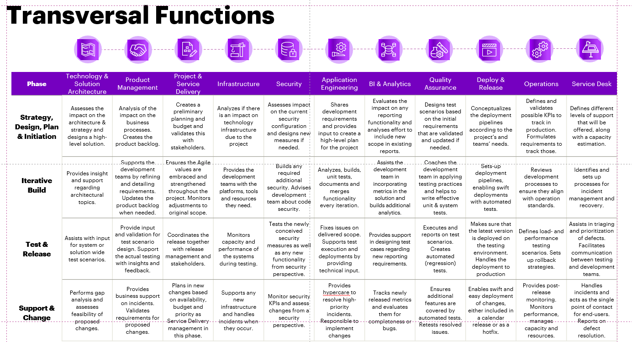

Slide 13
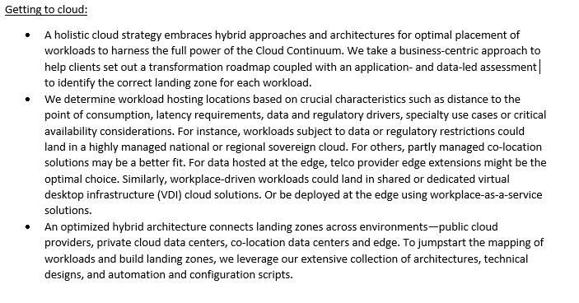
Public cloud not answer to everything, changing needs, not a static destination
Is utilities highly regulated? Certain challenges unique to the industry
Harmonize the complexity
Reason for adapting hybrid cloud – legal, compliance, vendor lock-in, specific solution case detailed understanding of the role each application and its data plays in accelerating business growth and optimizing operations. It requires a clear strategy that identifies the right combination of cloud services
Right operating model,
Fragmented environment, multiple siloed solutions used for different daily activities
Hybrid multi-cloud, single pane window
Benefits – people, tools, technology
Take existing org – how will they socialize? Re-org and be able to manage service catalog, infra operating,
What is biz case – infra org supporting on-prem workloads
Each of biz units have apps in cloud with own ops teams,
Optimal placement of workloads to harness full power of hybrid space
Enables smooth integration across a hybrid/multi-cloud landscape and provides unprecedented visibility throughout the enterprise. It acts as a unified command, control and decision support center for managing complex, hybrid environments.
As enterprises mature in their cloud adoption, the Continuum Control Plane would encompass applications, data, networks, people and processes, allowing developers and operators to automate everyday tasks and workflows at scale.
Clients’ burning need to gain oversight of their entire enterprise IT & biz
Sovereign cloud

